Slide 1

Presented By
Karthik Karunanithi

Slide 2

Agenda
Introduction
Overview
Requirements for installation
Installation
Sample Demo

Slide 3

Social Networking
Building a social networking website was assumed to be a Tedious task.
Hit your brains, hard to build a schema and a model
Along comes the copyright issues, shareholders and Opposers claiming their idea
Go to all legal hearings before finally making the website yours

Slide 4

What inspired Elgg ?
Ben Werdmuller and Dave Tosh launched in 2004 , the same year Facebook was launched

Slide 5
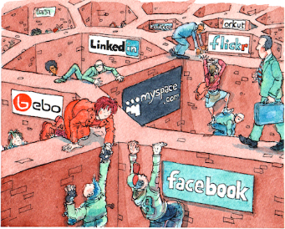
Elgg not Egg
An Open Source Social Networking API purely built on PHP
Functionalities to run our own social Networking engine
Like Facebook or a Campus wide social network for a university
An internal collaborative platform for your organization like Microsoft SharePoint

Slide 6

Zuckerberg be like…
OH NO!!!

Slide 7

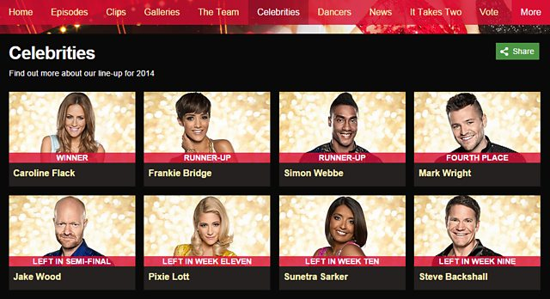
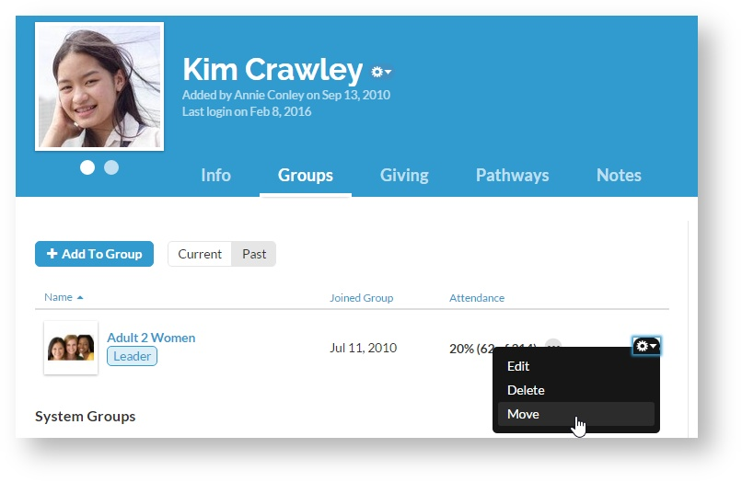
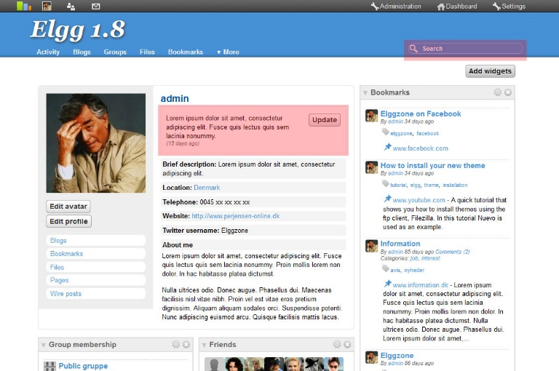
Core Features that make Elgg so powerful?
Elgg entity: A base class for the Elgg data model
Types:
ElggObject : User-created content, like blog posts, uploads, and bookmarks
ElggGroup : An organized group of users with their own profile page
ElggUser : A system user
ElggSite: The site served by the Elgg installation

Slide 8

Properties of Elgguser entity
Name : The user’s plain text name. e.g. “Hugh Jackman”
Username : Their login name. E.g. “hjackman”
Password : A hashed version of their password
Email : Their email address
Code : Their session code
last_action : The UNIX timestamp of the last time they loaded a page
Last_login : The UNIX timestamp of their last log in
Hugh Jackman

Slide 9
Additional Benefits
Supports Mobile and browser views
Enables to create an event
Extensible RESTful API, supports JSON, serialized PHP and XML
Ajax through JQuery and easily extendable with caching systems like MEMCACHE for increased performance
Has thousands of Themes for customization
Administrator account for site and user administration

Slide 10

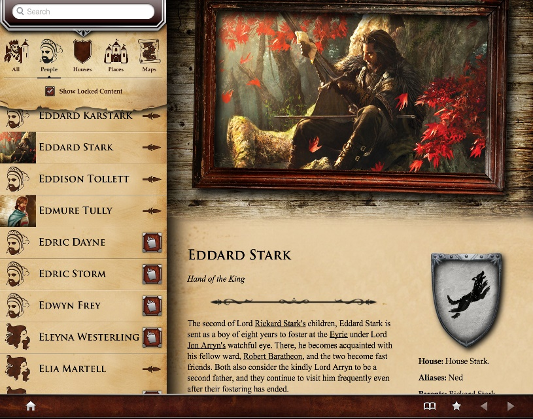


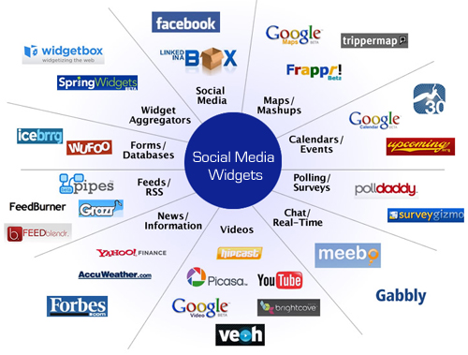

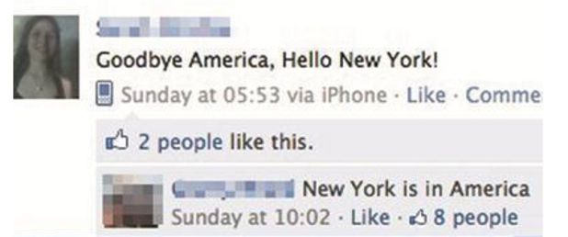
AVATAR
DASHBOARD
FRIENDS
WEB WIDGETS
PRIVATE MESSAGING
STATUS UPDATES

Slide 11
Requirements
MySQL 5+
PHP 5.2+ with :
GD(for graphics processing . Ex User icon Rescaling)
JSON(for API functionality)
Web server like Apache and Nginx
Official support for PHP running as an Apache module and Nginx with PHP-FPM using FastCGI

Slide 12

One Major Requirement
Don’t be this guy
A certain amount of technical knowledge
Or Access to someone who does ,like a System Administrator

Slide 13
Installation
We need our own Web-server or Host on sites like Hostinger, C-panel
Download the latest version of elgg from https://elgg.org/
Upload the ZIP file with an FTP client to your server or manually
Unzip the files in your domain’s document root.
A special folder to store uploaded files including profile icons and photos
Create a new MySQL database for Elgg

Slide 14
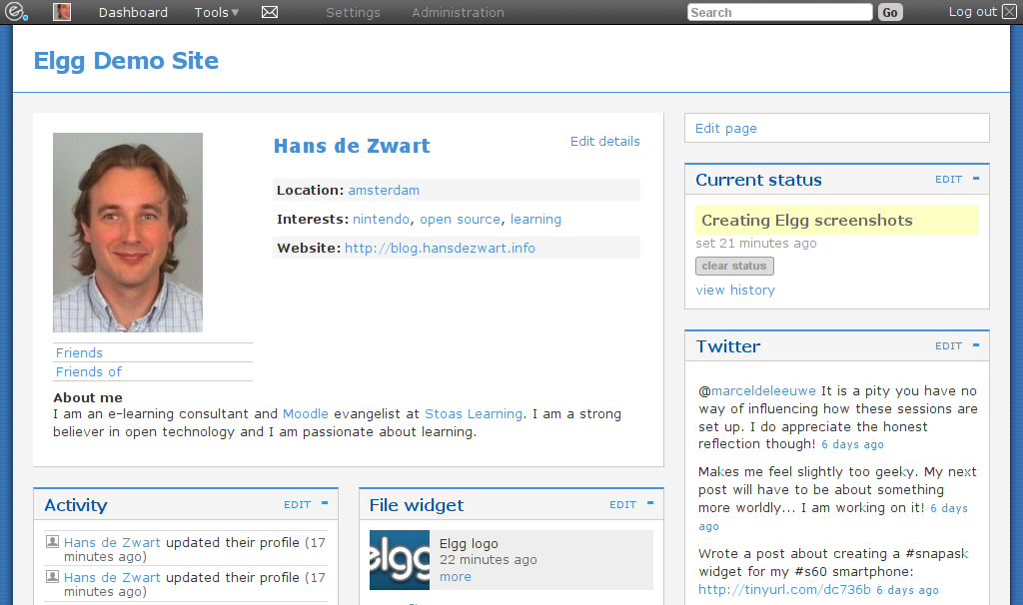
A Demo Website

Slide 15
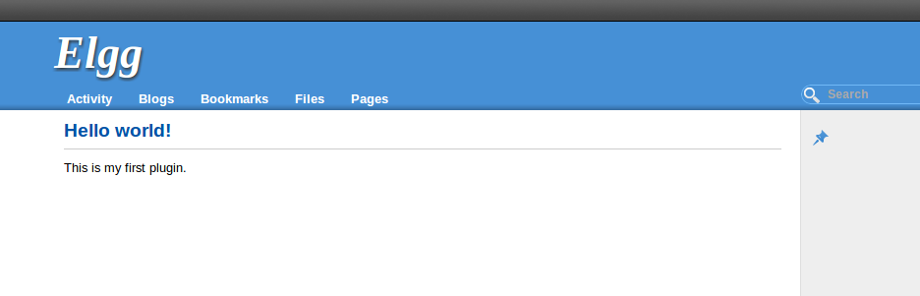
Elgg Hello World
<?php
elgg_register_event_handler('init', 'system', 'hello_world_init');
function hello_world_init() {
elgg_register_page_handler('hello', 'hello_world_page_handler');
}
function hello_world_page_handler() {
echo elgg_view_resource('hello');
}

Slide 16

Moral : Don’t do a Zuckerberg , Keep calm and do Elgg

